Slide 1


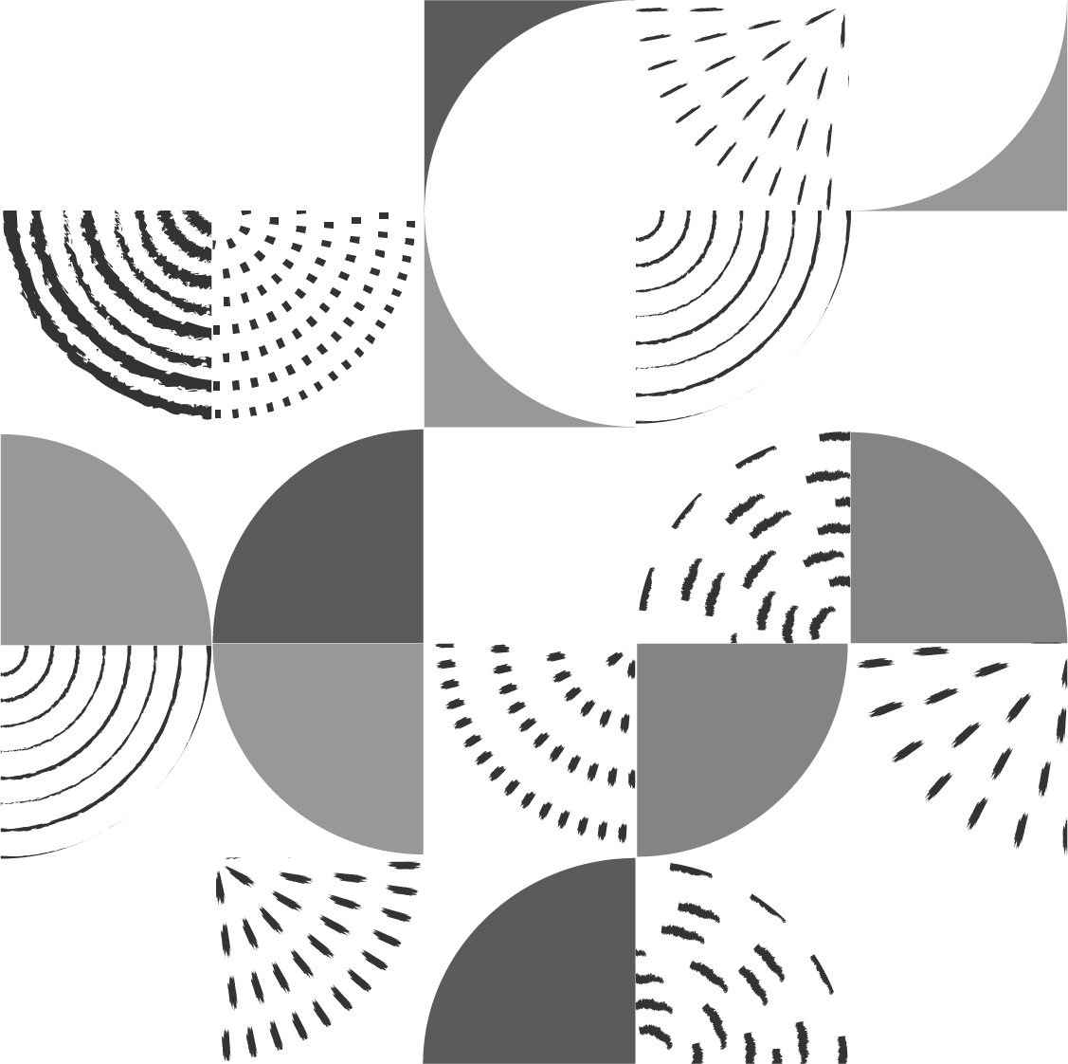
Bank Marketing Analysis
Team Members:
Yash Patole | CWID: 10460520
Omkar Sinha | CWID: 10468312
Daksh Bhuva | CWID: 10475468
Anish Malhotra | CWID: 10475537
Knowledge Discovery & Data Mining

Slide 2
Introduction
The Bank Marketing dataset is related with direct marketing campaigns of a Portuguese banking institution.
The marketing campaigns were based on phone calls.
Often, more than one contact to the same client was required, in order to access if the product (bank term deposit) would be (or not) subscribed.

Slide 3
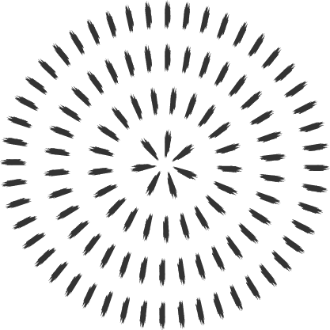
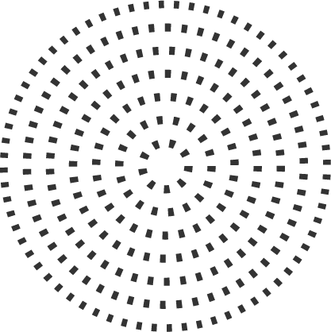
The Data
The Bank Marketing dataset is from Kaggle. It consists of 11,162 rows and 17 columns.
The classification goal is to predict if the client will subscribe a term deposit or not

Slide 4
Attributes of the dataset
Key | Datatype | Description
age | int | age of client
job | char | type of job
marital | char | marital status
education | char | education level
default | char | has credit in default?
balance | int | average yearly balance
housing | char | has housing loan?
loan | char | has perosnal loan?
Key | Datatype | Description
contact | char | communication type
day | int | last contact month day
month | char | last contact month
duration | int | last contact duration
campaign | int | number of contacts during this campaign
pdays | int | days passed after last contact
previous | int | number of contacts before this campaign
poutcome | char | outcome of previous campaign

Slide 5
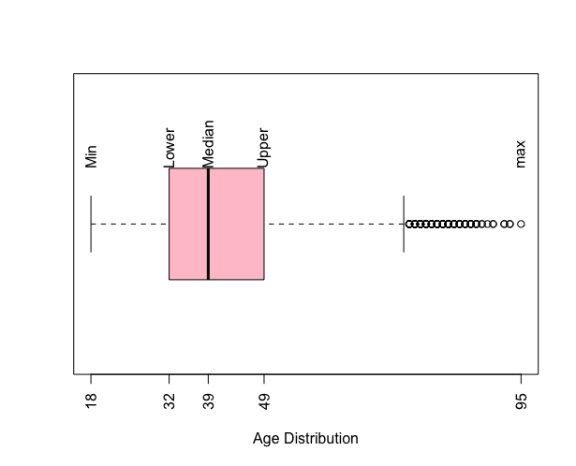
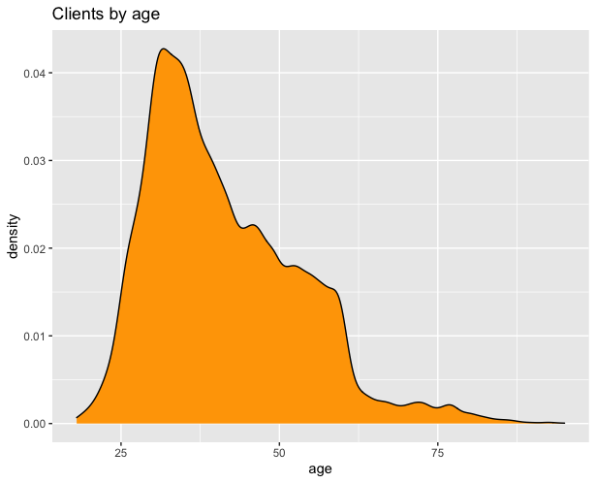
Data Visualization
Boxplot of attribute ‘age’
Density Distribution of attribute ‘age’

Slide 6

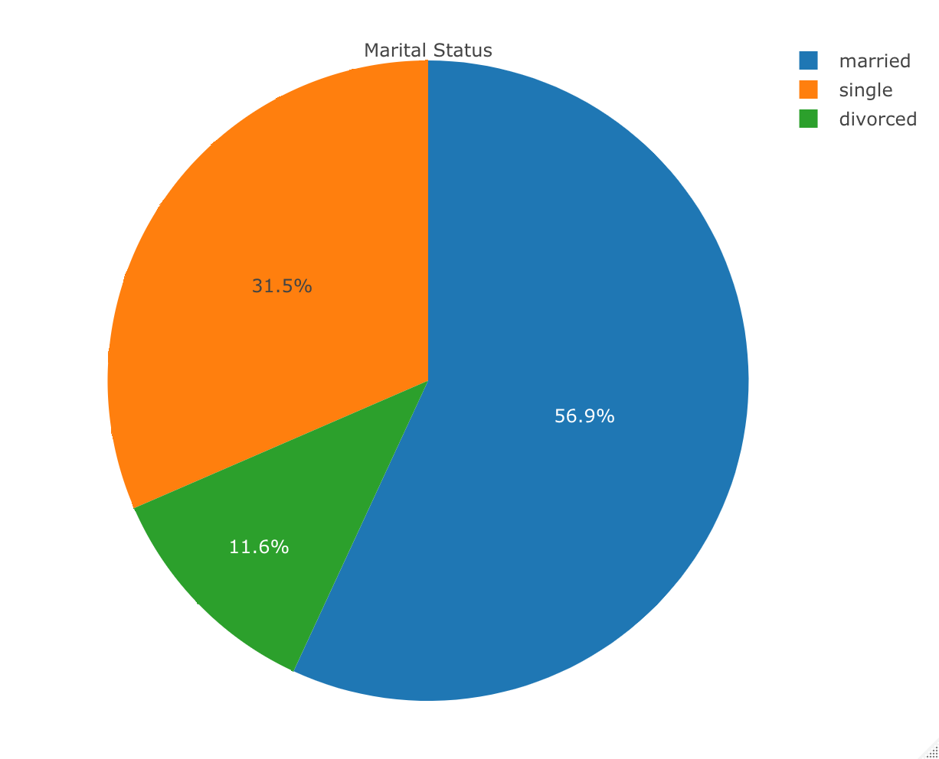
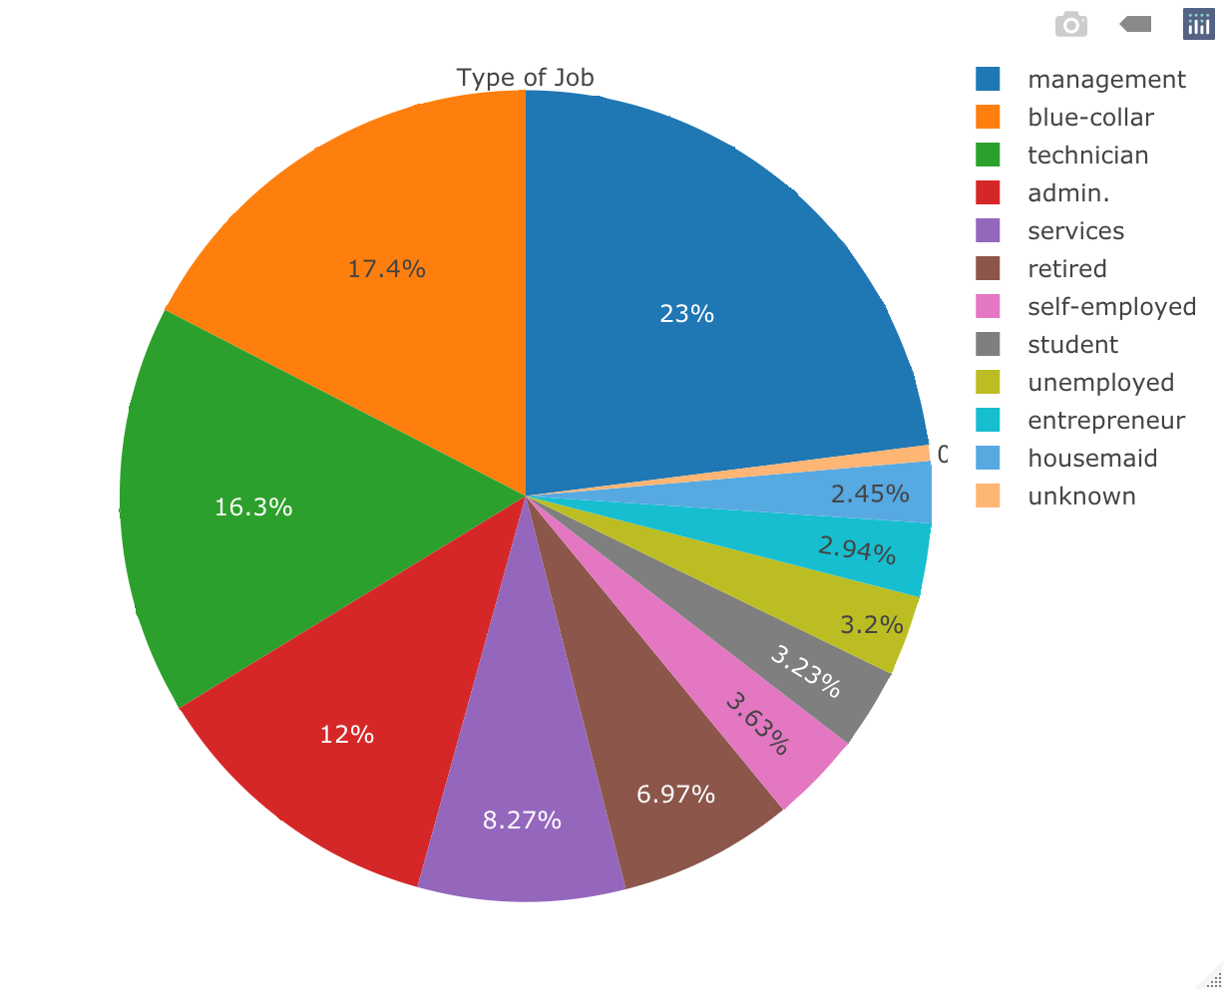
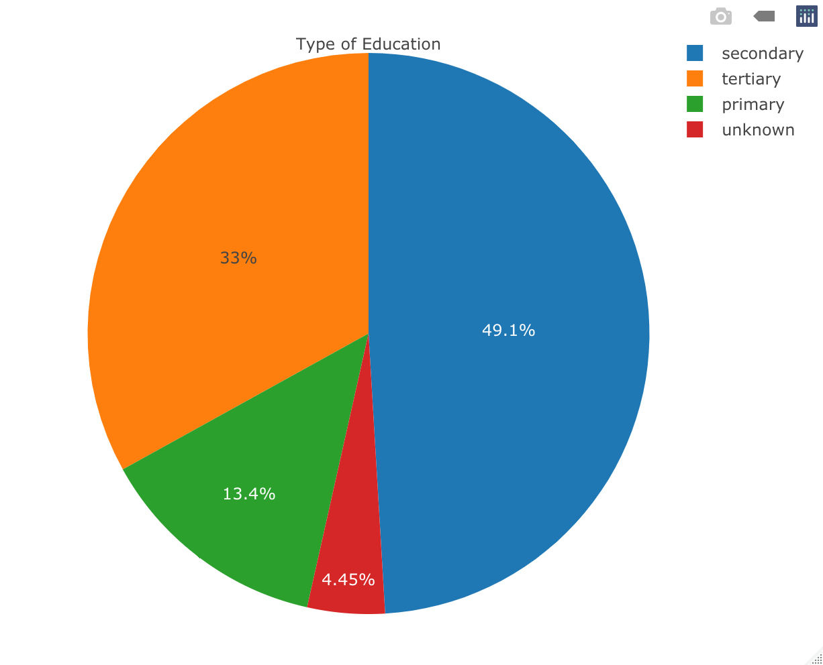
Data Visualization (Pie Chart)
Attribute ‘job’
Attribute ‘marital’
Attribute ‘education’

Slide 7
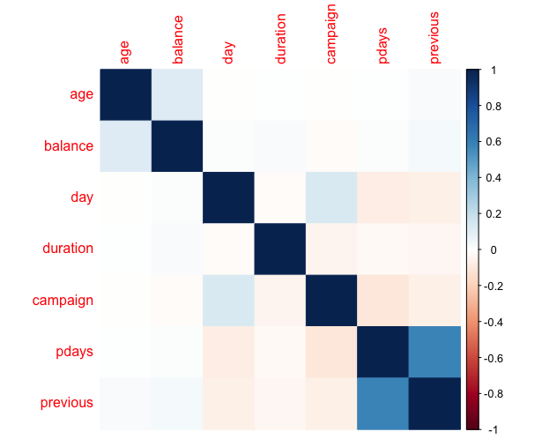
Data Analysis
Correlation Matrix

Slide 8
Splitting the dataset
Training Set
Test Data
70%
30%

Slide 9
Algorithms
KNN
Naïve Bayes
Random Forest
Self-Organizing Map
K-Means Clustering
SVM

Slide 10
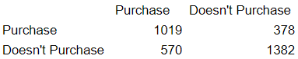
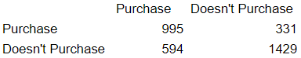
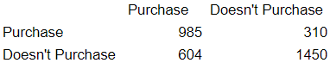
KNN
K = 3
K = 5
K = 10
Accuracy
71.69
Accuracy
72.37
Accuracy
72.70

Slide 11
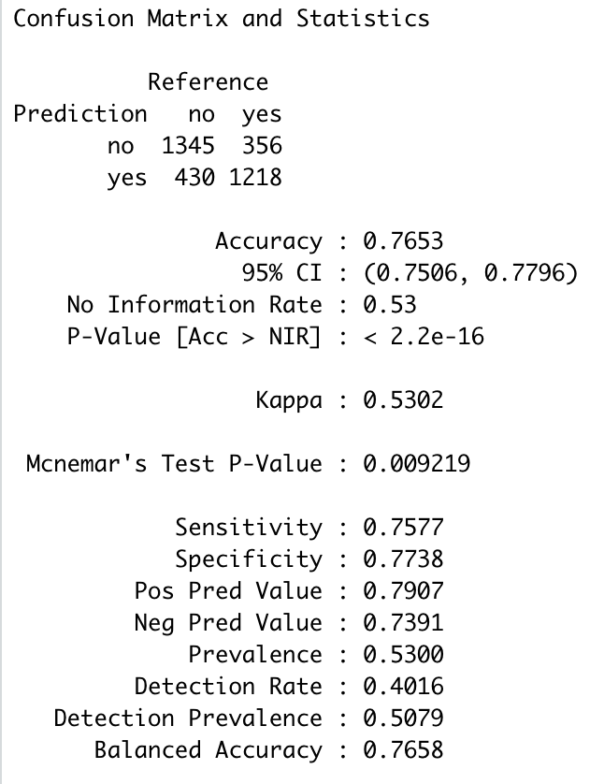
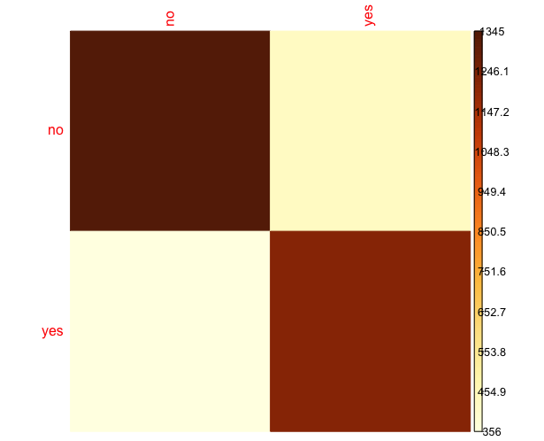
Naïve Bayes
Confusion
Accuracy
76.50

Slide 12
Random Forest
A random forest is a supervised machine learning algorithm that is constructed from decision tree algorithms. This algorithm is applied in various industries such as banking and e-commerce to predict behavior and outcomes.
It utilizes ensemble learning, which is a technique that combines many classifiers to provide solutions to complex problems.
Advantages of Random Forests are:
It’s more accurate than the decision tree algorithm.
It provides an effective way of handling missing data.
It can produce a reasonable prediction without hyper-parameter tuning.
It solves the issue of overfitting in decision trees.

Slide 13
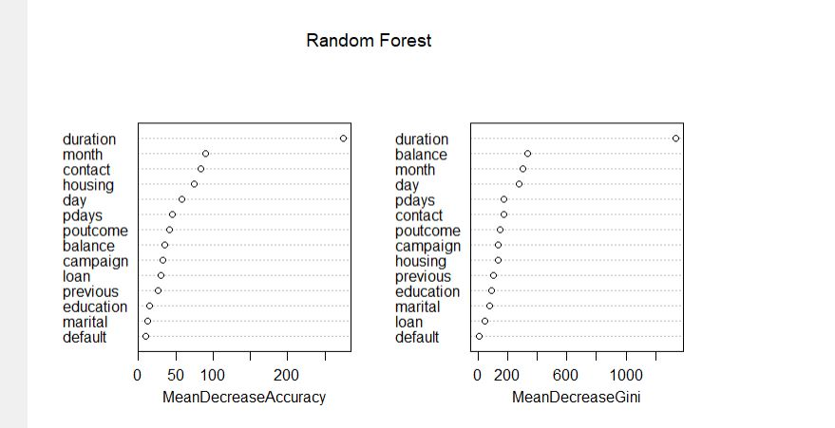
Random Forest
These plots helps to Highlight the importance of the given variable in the dataset.
the prediction accuracy on the out-of-bag portion of the data is recorded. Then the same is done after permuting each predictor variable.
The difference between the two accuracies are then averaged over all trees and normalized by the standard error.
For regression, the MSE is computed on the out-of-bag data for each tree, and then the same computed after permuting a variable.

Slide 14
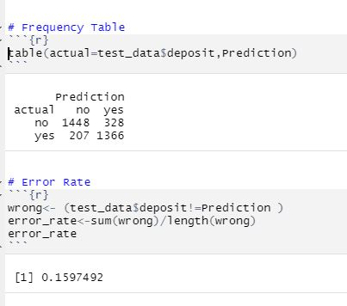
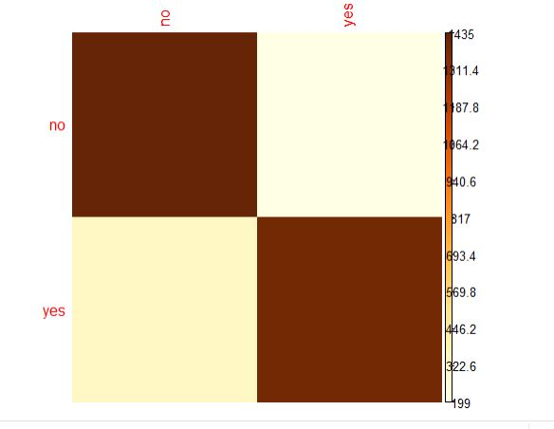
Random Forest
Confusion
Accuracy
84.14

Slide 15
K-Means Clustering
A K-means clustering algorithm tries to group similar items in the form of clusters. The number of groups is represented by K.
It finds the similarity between the items and groups them into the clusters. K-means clustering algorithm works in three steps. Those steps are:
Select the K- values.
Initialize the centroids.
Select the group and find the average.
Advantages of K-means are:
It is very simple to implement.
It is scalable to a huge data set and faster to large datasets.
it adapts the new examples very frequently.
Generalization of clusters for different shapes and sizes.

Slide 16
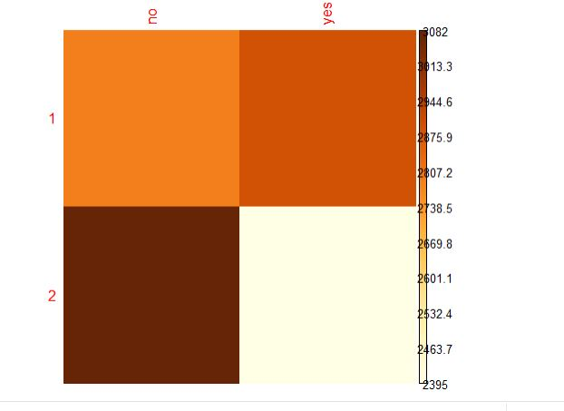
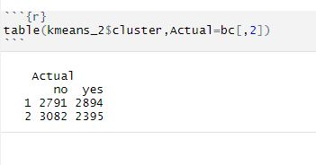
K-Means Clustering
Confusion
Cluster Size: 2
Accuracy
46.46

Slide 17
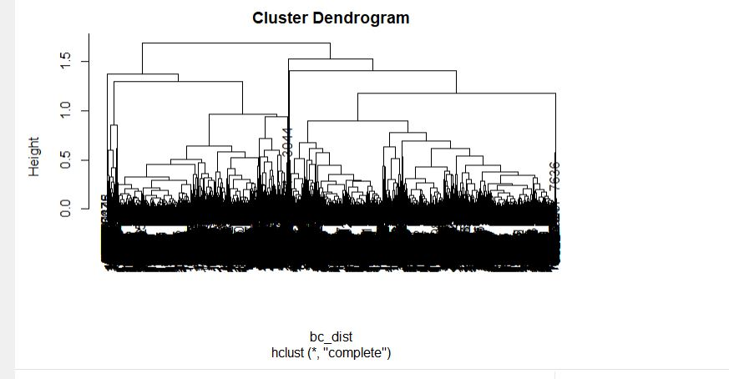
Hierarchical Clustering
Hierarchical clustering is where you build a cluster tree (a dendrogram) to represent data, where each group (or “node”) links to two or more successor groups.
Each node in the cluster tree contains a group of similar data; Nodes group on the graph next to other, similar nodes. Clusters at one level join with clusters in the next level up, using a degree of similarity.
A dendrogram is a type of tree diagram showing hierarchical clustering — relationships between similar sets of data.

Slide 18
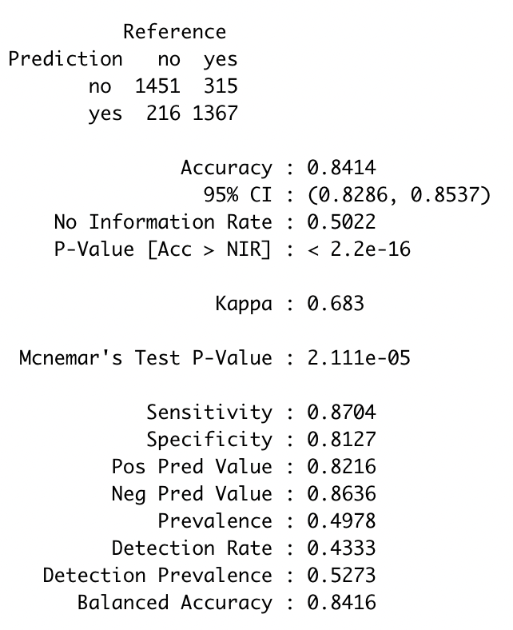
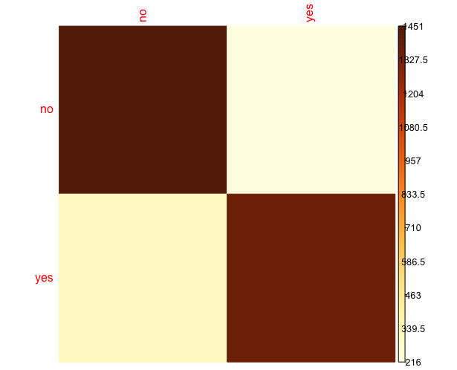
SVM
Confusion
Accuracy
84.14

Slide 19
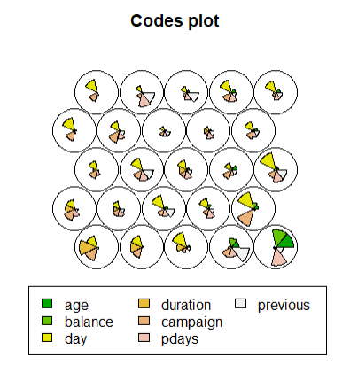
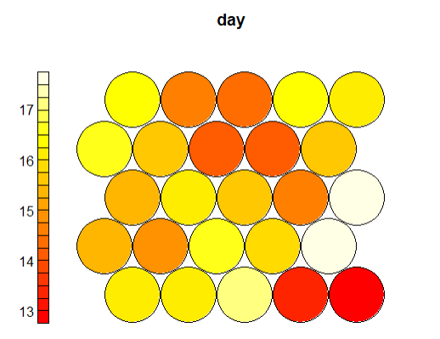
Self-Organizing Map (Kohonen)
A self-organizing map (SOM) is an
unsupervised machine learning technique used to produce a low-dimensional (typically two-dimensional) representation of a higher dimensional data set while preserving the topological structure of the data. It was created by Teuvo Kohonen.

Slide 20
Comparison

Slide 21

Conclusion
Random Forest and SVM have high
accuracies of around 84%.
Random Forest and SVM performed
well across the bank marketing dataset.
‘Yes’ means that the client has
subscribed a term deposit. ’No’ means
that client has not subscribed a term
Deposit.

Slide 22

Thank You

